Slide 1
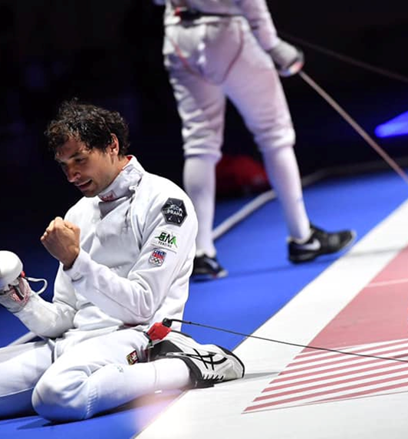
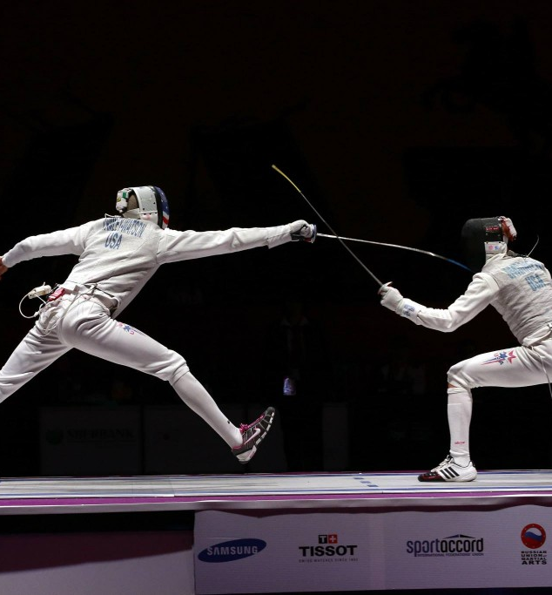

REFEREES SEMINAR
EPEE
Tato fotka od autora Neznámý autor s licencí CC BY-SA

Slide 2
REFEREE
DRESS CODE
TIME MANAGEMENT
IMPARTIALITY
BEHAVIOUR
FOCUS
STRICT
ROLE AND RESPONSABILITIES

Slide 3


What a good referee should be?
A good referee should be fair, impartial and consistent in enforcing the rules. He should have good communication skills, be decisive and remain calm under pressure. In addition, a good referee should have a thorough knowledge of the rules of the game and be able to manage and control the game effectively.

Slide 4
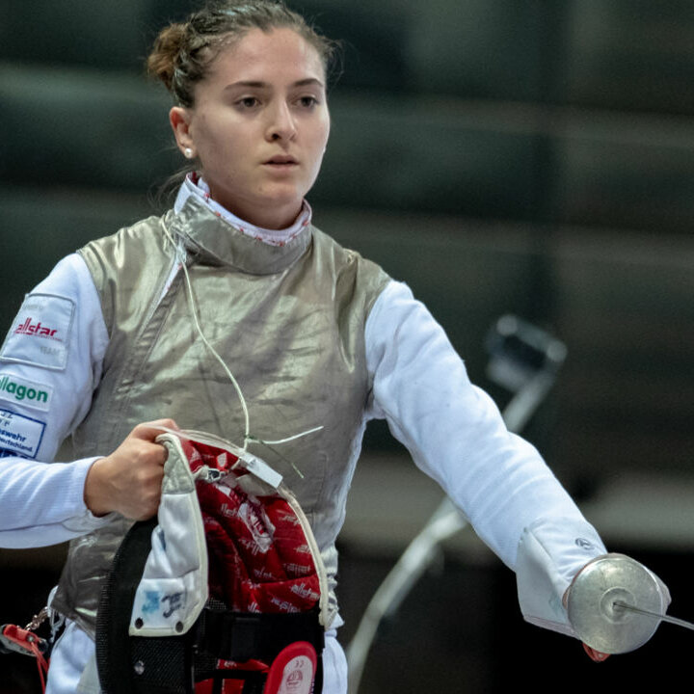
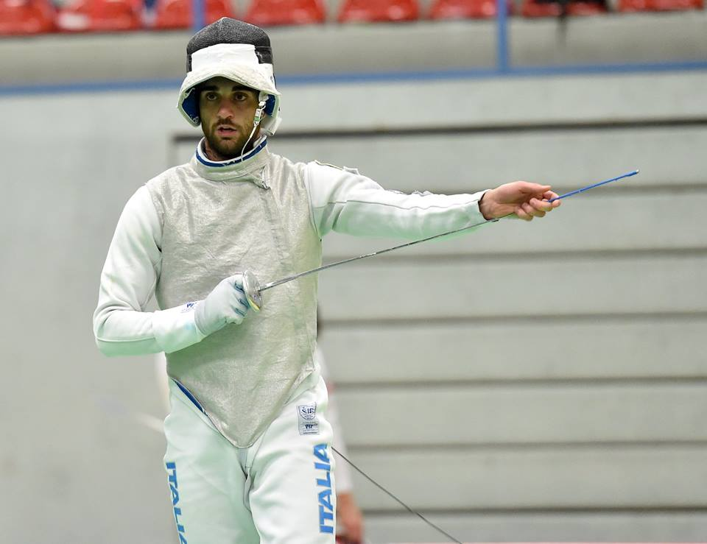
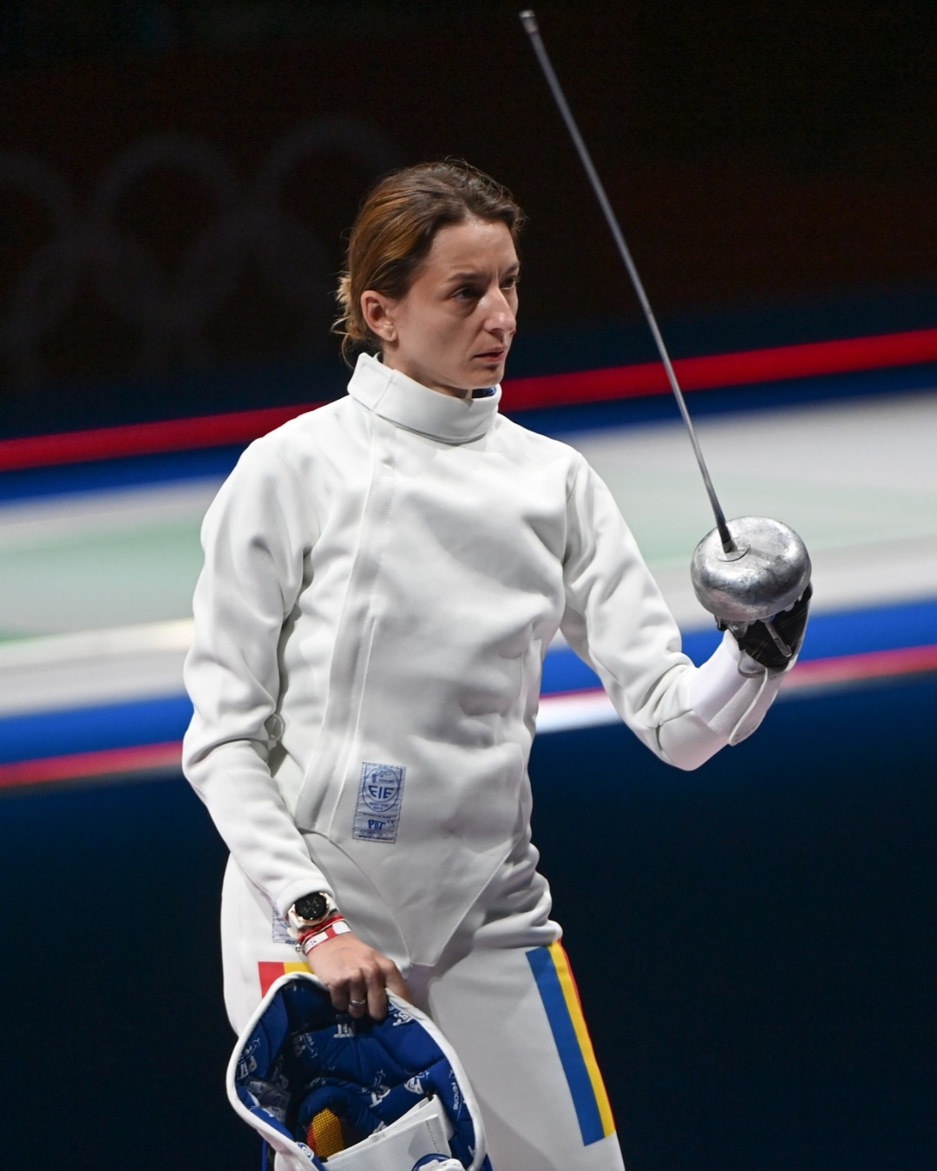
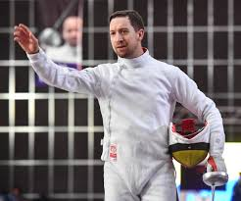
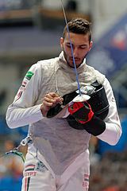
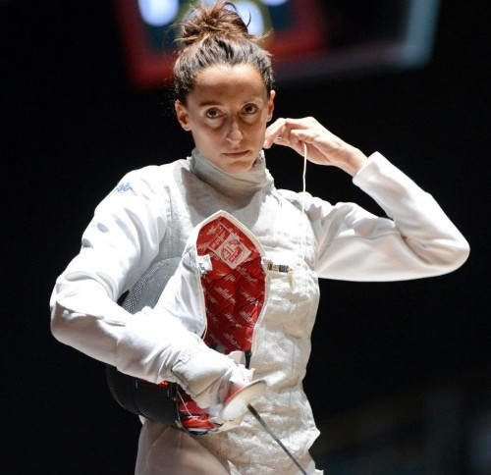
Before the match
Left hander always on left side (ind/teams)
Hair fixed according the rules
Fencer has to be ready
Control of materiel by referee
Blade deflection
Salute

Slide 5
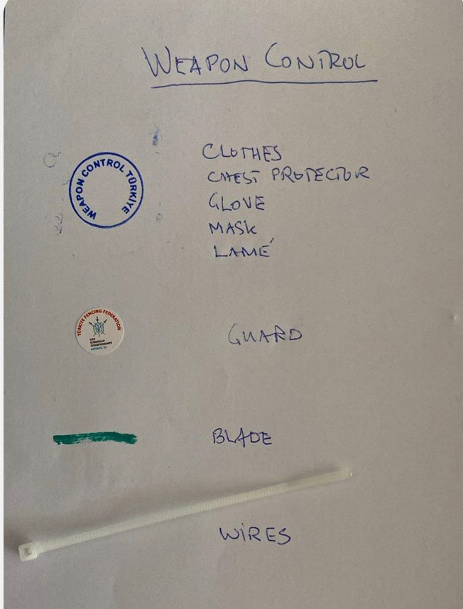
WEAPON CONTROL !

Slide 6
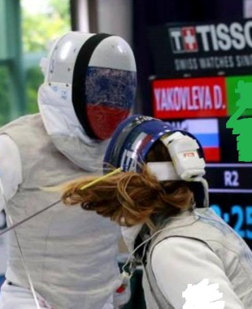
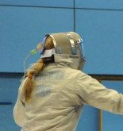
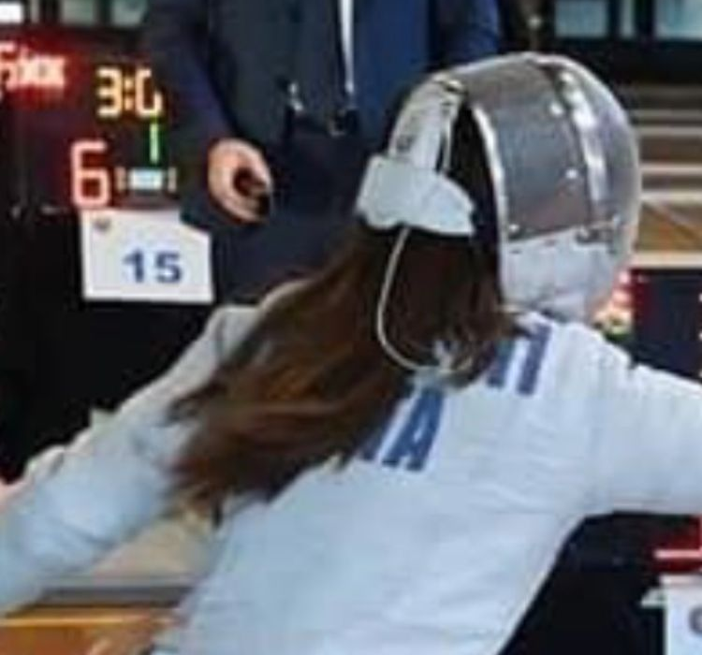
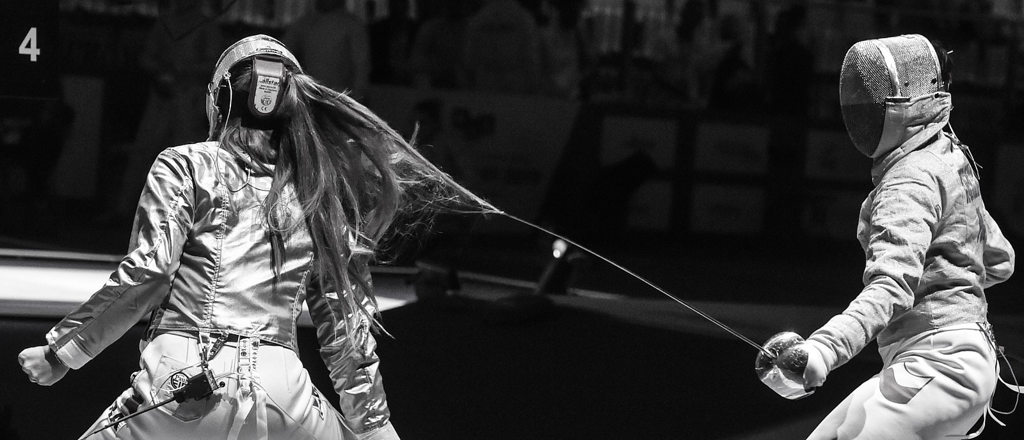
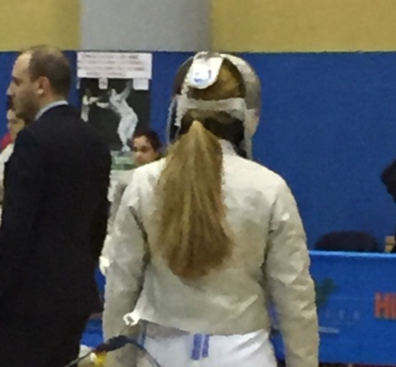
Hair fixing

Slide 7
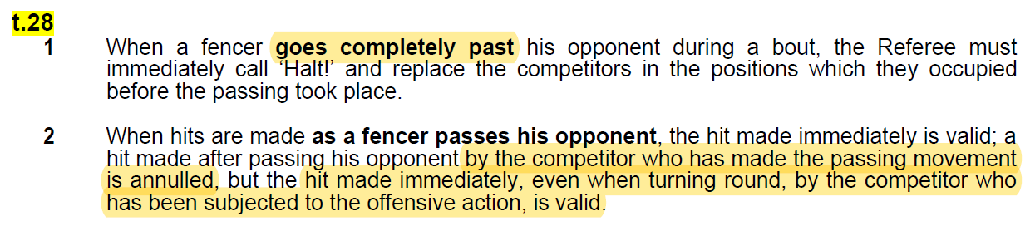
Passing the oponent

Slide 8
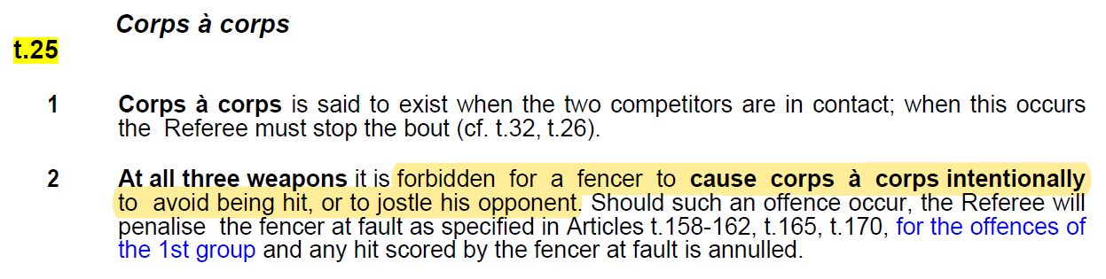
CORP a CORP

Slide 9
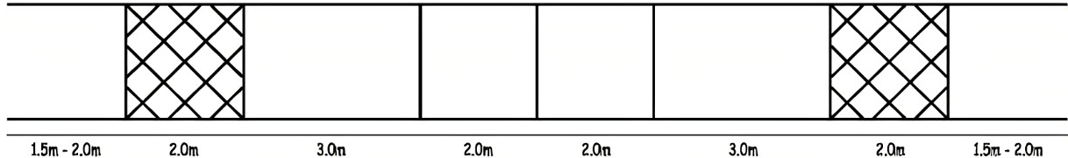
Crossing the limits
Both feets outside
>>> technical touche
end line
on-guard line
centre line
One foot outside >>> 1m back
Two feet outside >>> 1m back and cancel the hit

Slide 10
Hit made during or after fall down
Hit has to be canceled in any of case
Falling down intentionaly yellow card

Slide 11
ALT NOT TO EARLY!
NOT TO LATE!
Crossing the limits (first riposte/remise)
Corp a corp simple, to avoid being hit
Passing the opponent (first riposte/remise)
Falling down intentionally or not
Non-combativity
…

Slide 12
Non-combativity
P
P
P
Referee has to say Alt! after 1 minute without hit
> P-yellow for both fencers
>> P-red for both fencers
>>> P-black with lower score (or lower seeding)
! Non-combativity does not exist during 14:14, 44:44 and extra minute

Slide 13
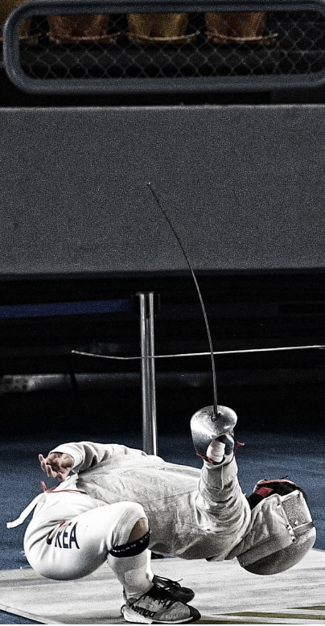
DO NOT ALLOW COACHES TO
COACHING DURING THE FIGHT
Coaching is not allowed after „Allez!“ till „Alt!“. Fencer can have the consultation during 1 minute break. Coach during the poole does not exist and can not be in the area of play.
YELLING AT YOU
No one can yell at You for any reason. You have to controle the bout / match and give the penalties.

Slide 14
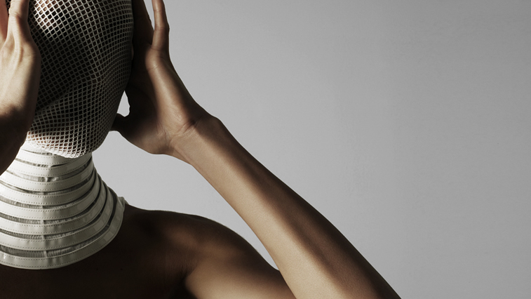
THANKS

