Slide 1
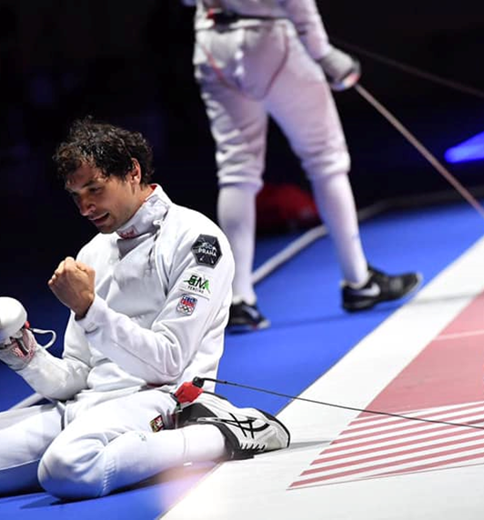
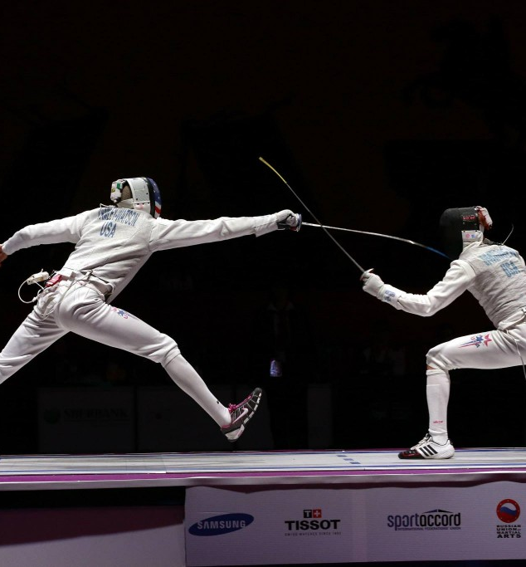

REFEREES SEMINAR
SABRE
Tato fotka od autora Neznámý autor s licencí CC BY-SA

Slide 2
REFEREE
DRESS CODE
TIME MANAGEMENT
IMPARTIALITY
BEHAVIOUR
FOCUS
STRICT
ROLE AND RESPONSABILITIES

Slide 3


What a good referee should be?
A good referee should be fair, impartial and consistent in enforcing the rules. He should have good communication skills, be decisive and remain calm under pressure. In addition, a good referee should have a thorough knowledge of the rules of the game and be able to manage and control the game effectively.

Slide 4
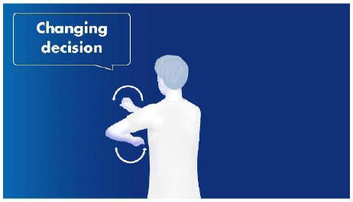
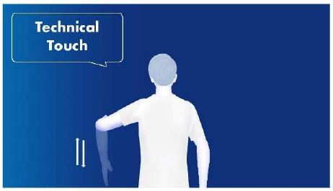
GESTES WILL BE PERFECT
… ENGARDE / PRET / ALLEZ ALSO
CHANGING DECISION
Referee changed his / her decision after video request.
TOUCHE TECHNIQUE
When the fencer cross end line and receive technical hit.

Slide 5
ATTENTION !
Self-confidence (not egocentrism) >>> use the voice and body language
Knowledge of the RULES >>> learn the rules and solve any situation alone
Respect the others >>> act as team player

Slide 6
Hit made during or after fall down
Hit has to be canceled in any of case
Falling down intentionaly yellow card

Slide 7
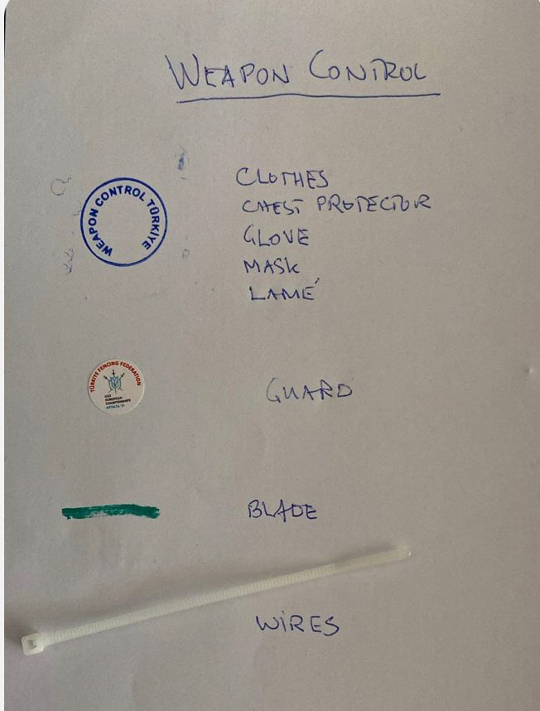
WEAPON CONTROL !

Slide 8
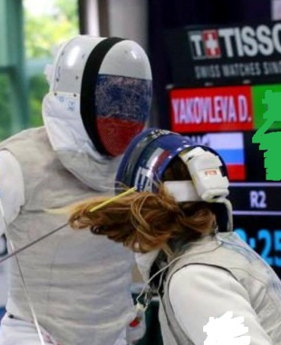
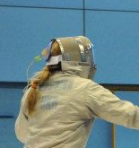
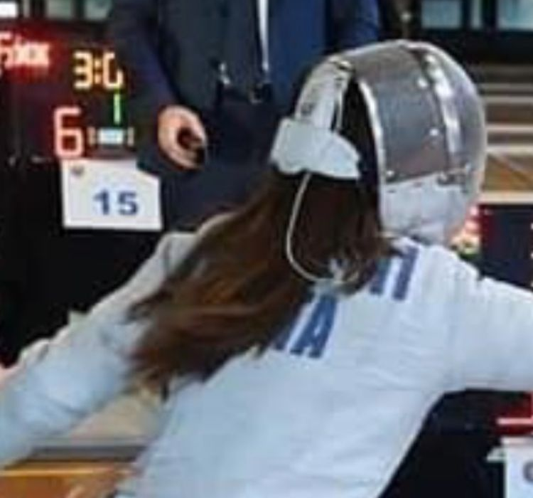
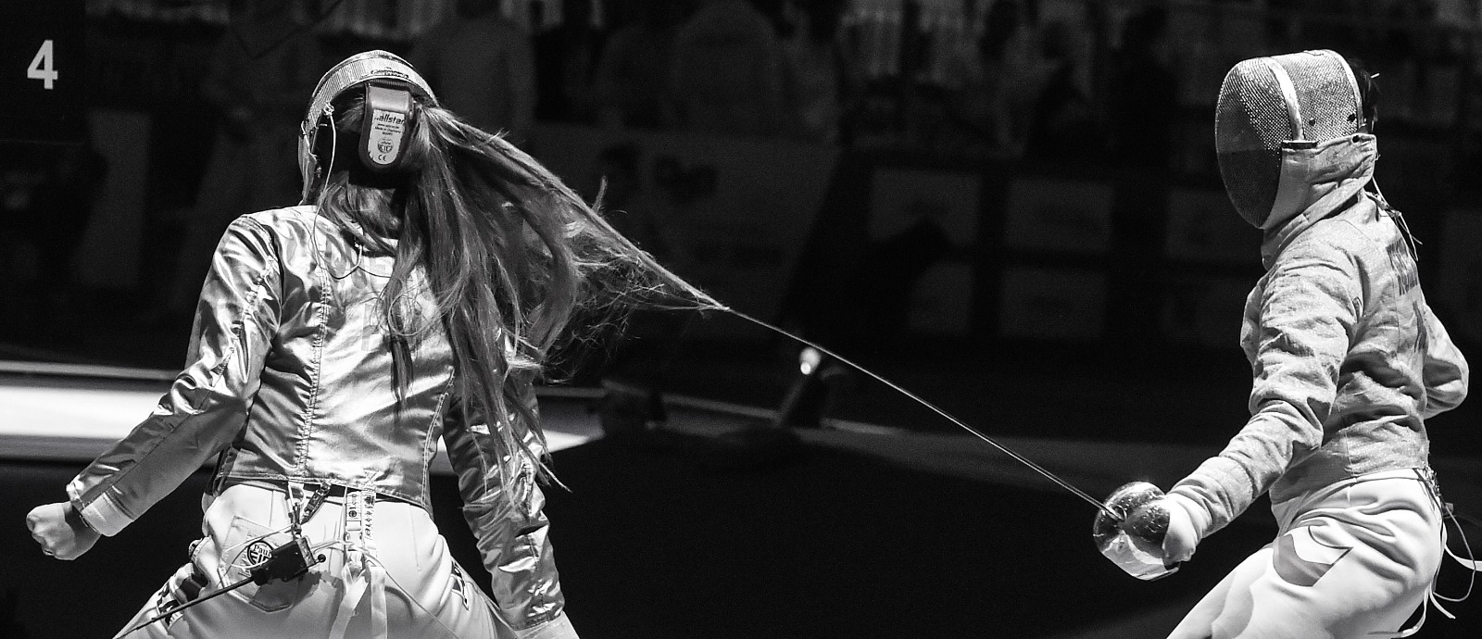
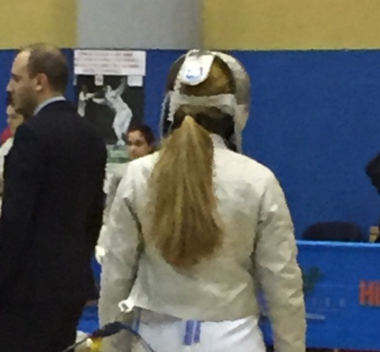
Hair fixing

Slide 9
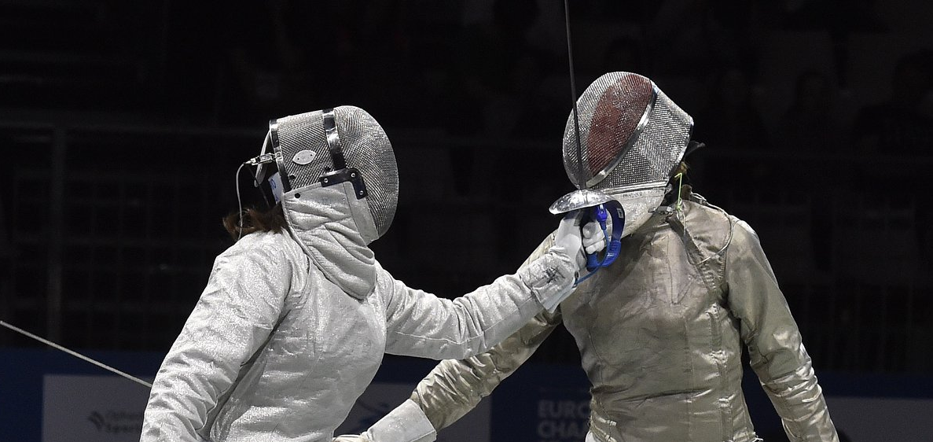
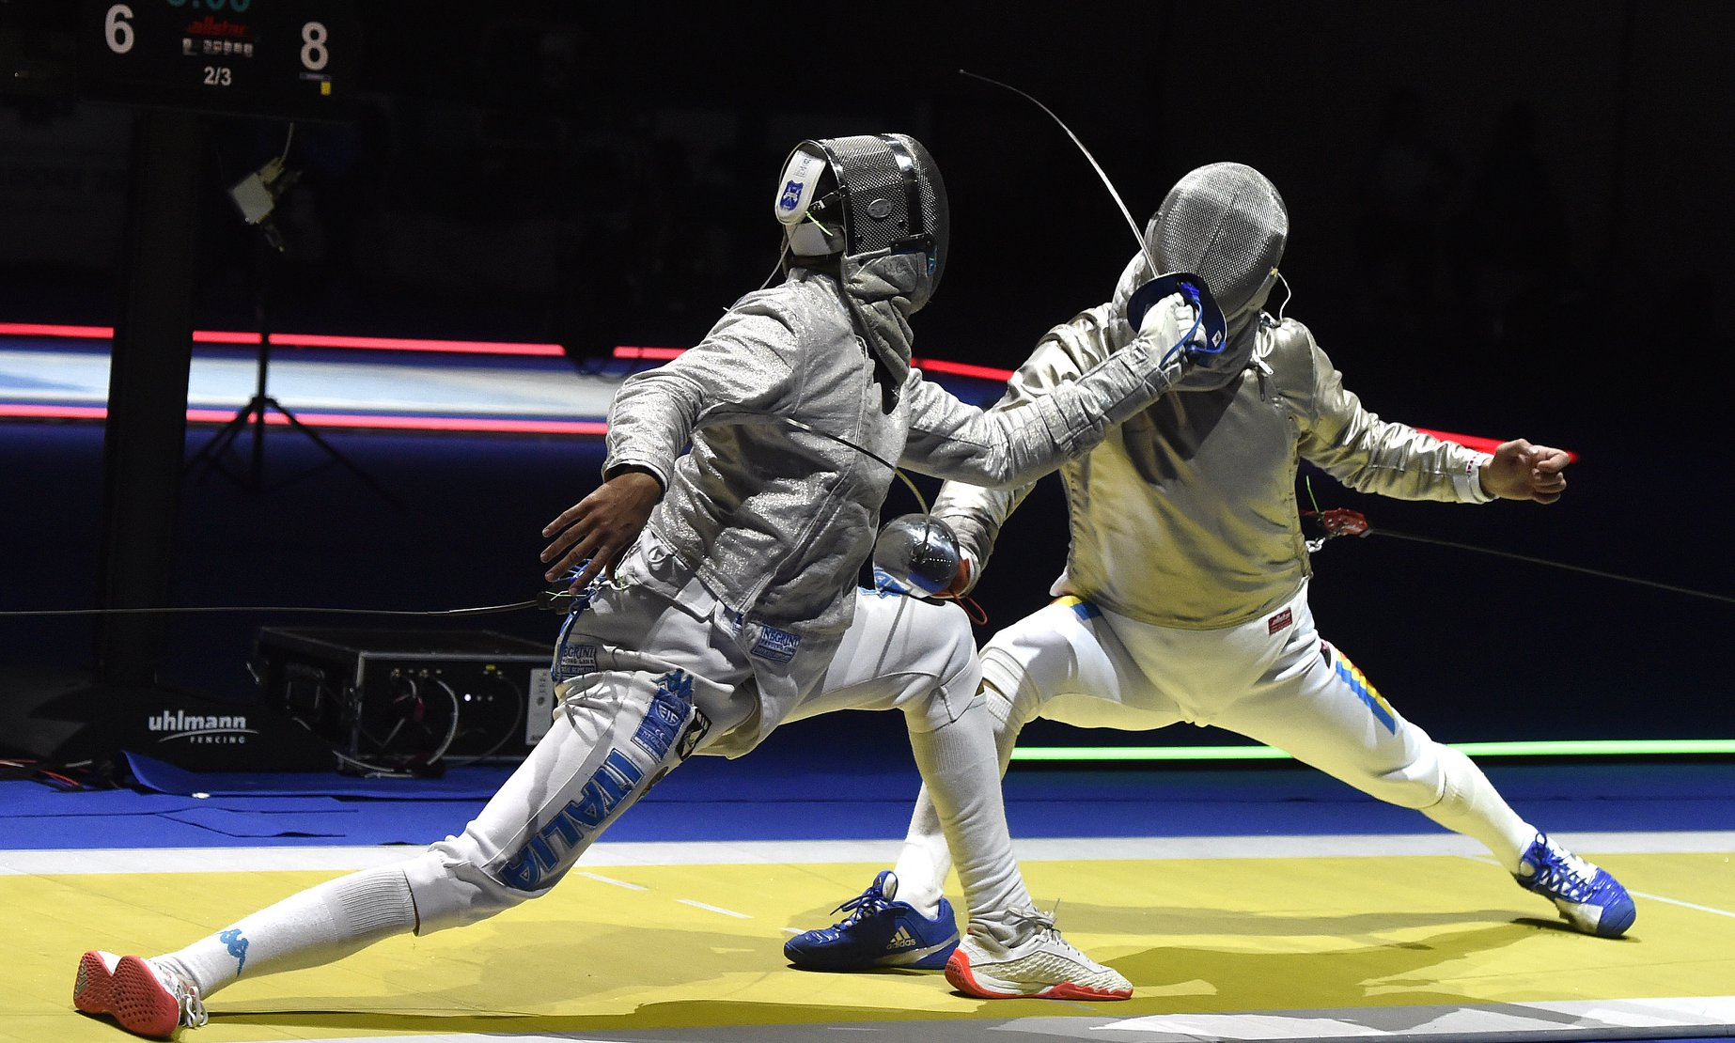
Hit with the guard

Slide 10
False-start =

Slide 11
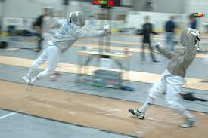
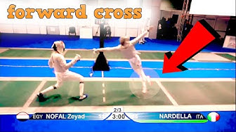
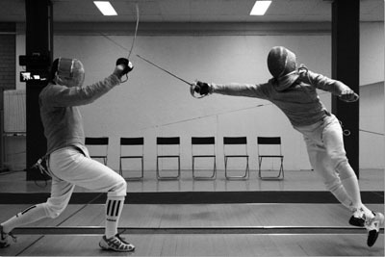
Cross-step

Slide 12
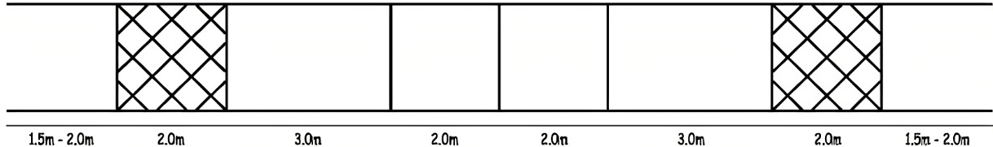
Crossing the limits
Both feets outside
>>> technical touche
end line
on-guard line
centre line
One foot outside >>> 1m back
Two feet outside >>> 1m back and cancel the hit

Slide 13
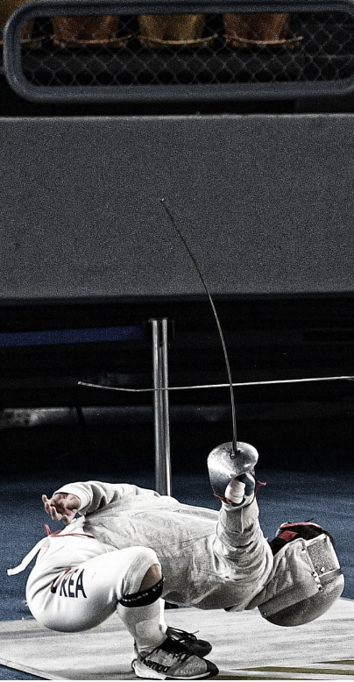
DO NOT ALLOW COACHES TO
COACHING DURING THE FIGHT
Coaching is not allowed after „Allez!“ till „Alt!“. Fencer can have the consultation during 1 minute break. Coach during the poole does not exist and can not be in the area of play.
YELLING AT YOU
No one can yell at You for any reason. You have to controle the bout / match and give the penalties.

Slide 14
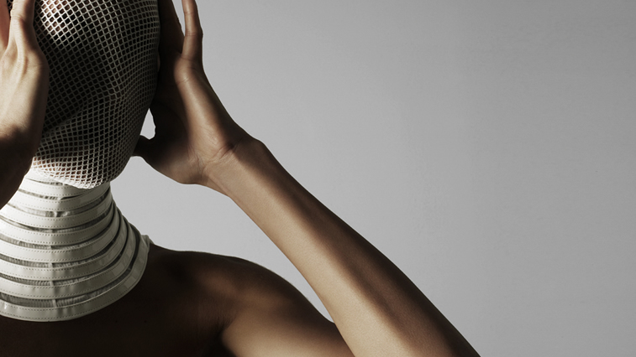
THANKS

