Slide 1
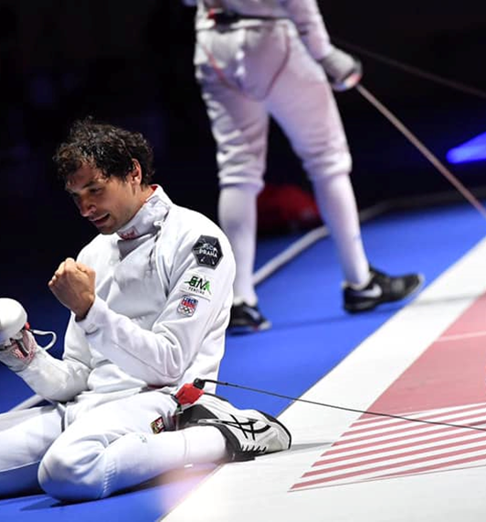
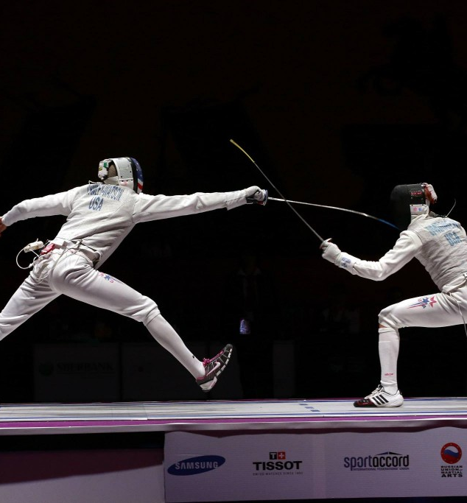

REFEREES SEMINAR
FOIL
Tato fotka od autora Neznámý autor s licencí CC BY-SA

Slide 2


What a good referee should be?
A good referee should be fair, impartial and consistent in enforcing the rules. He should have good communication skills, be decisive and remain calm under pressure. In addition, a good referee should have a thorough knowledge of the rules of the game and be able to manage and control the game effectively.

Slide 3
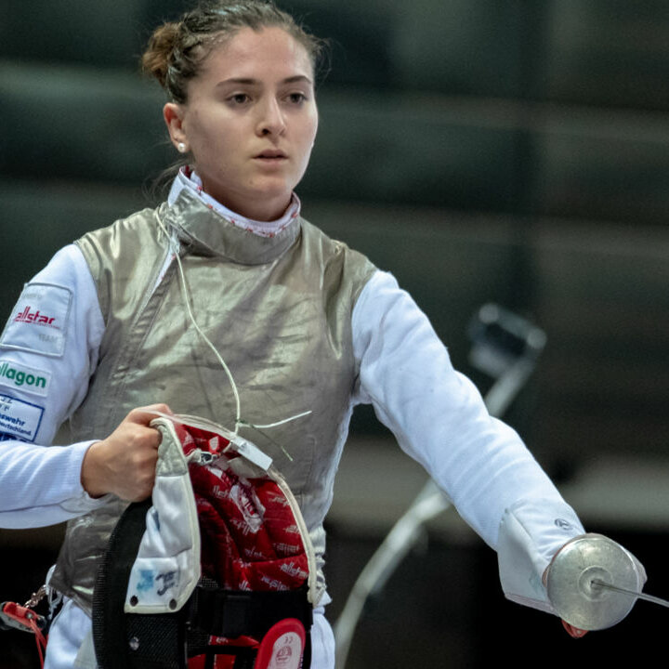
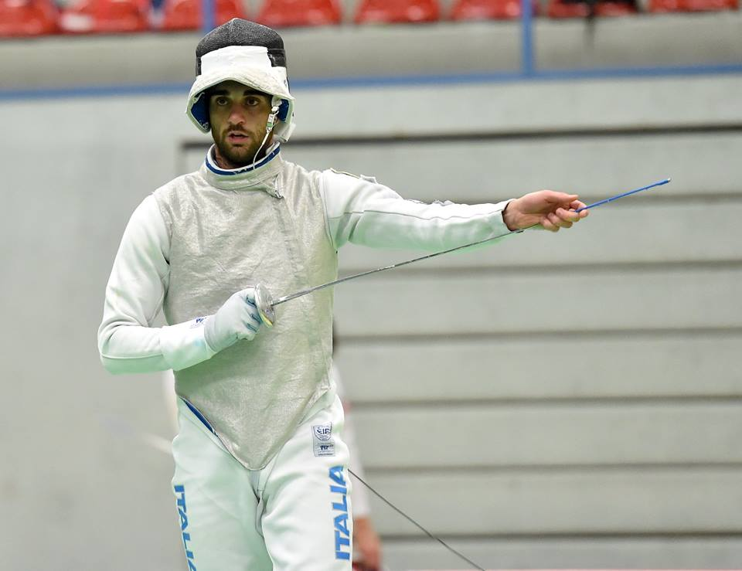
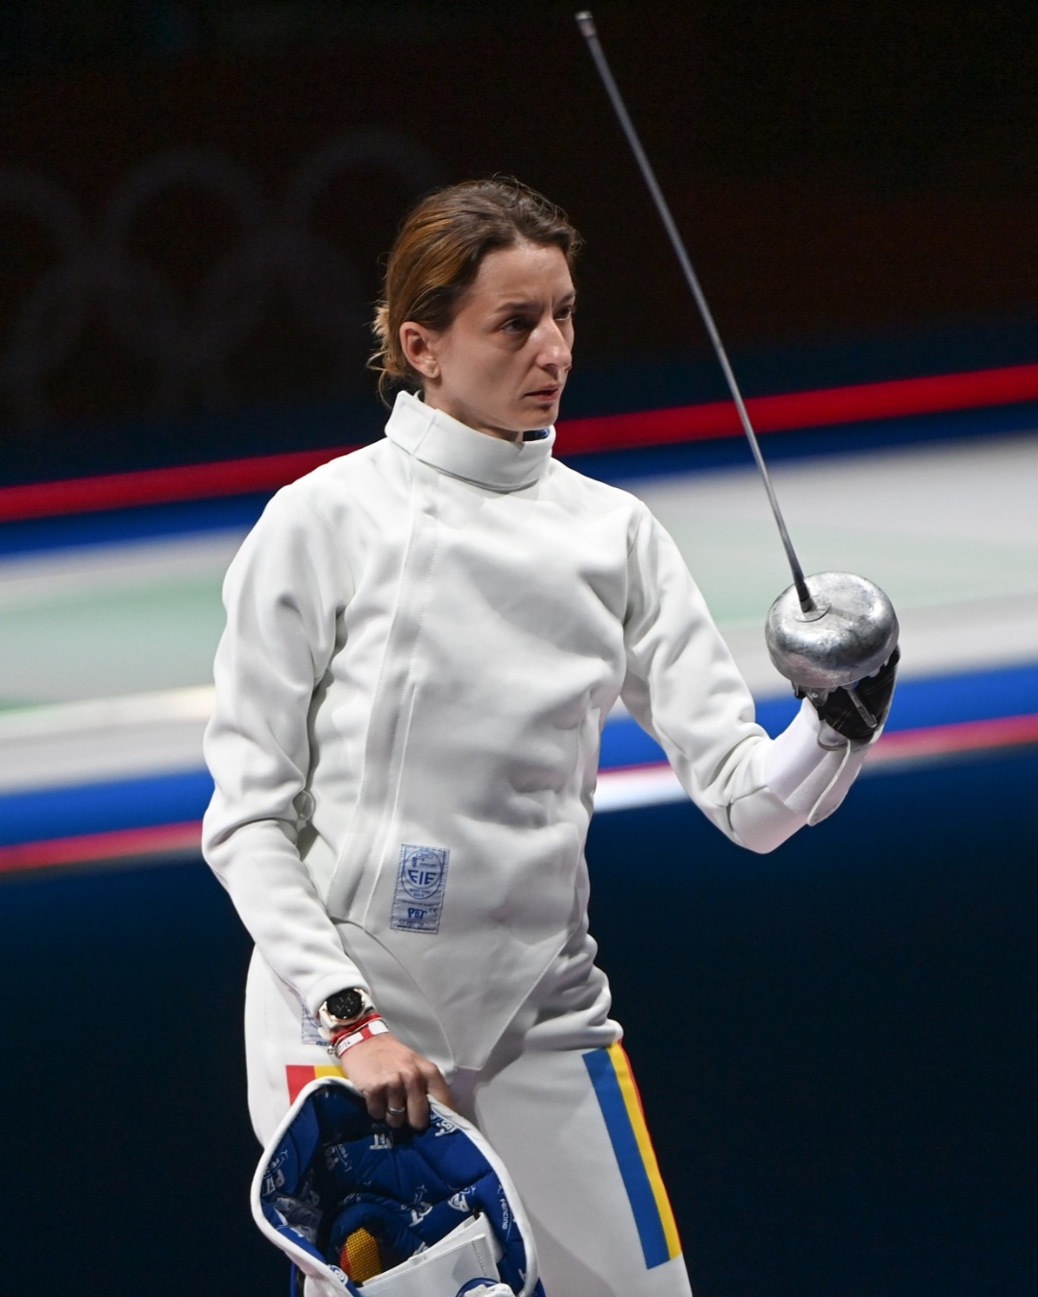
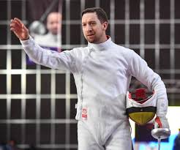
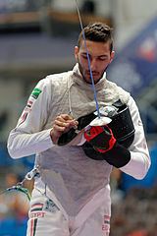
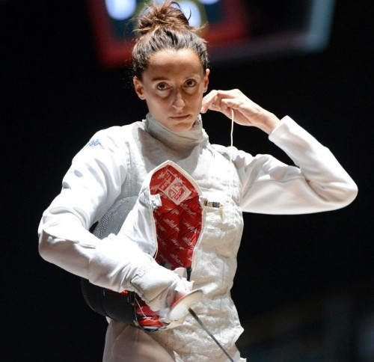
Before the match
Left hander always on left side (ind/teams)
Hair fixed according the rules
Fencer has to be ready
Control of materiel by referee
Blade deflection
Salute

Slide 4
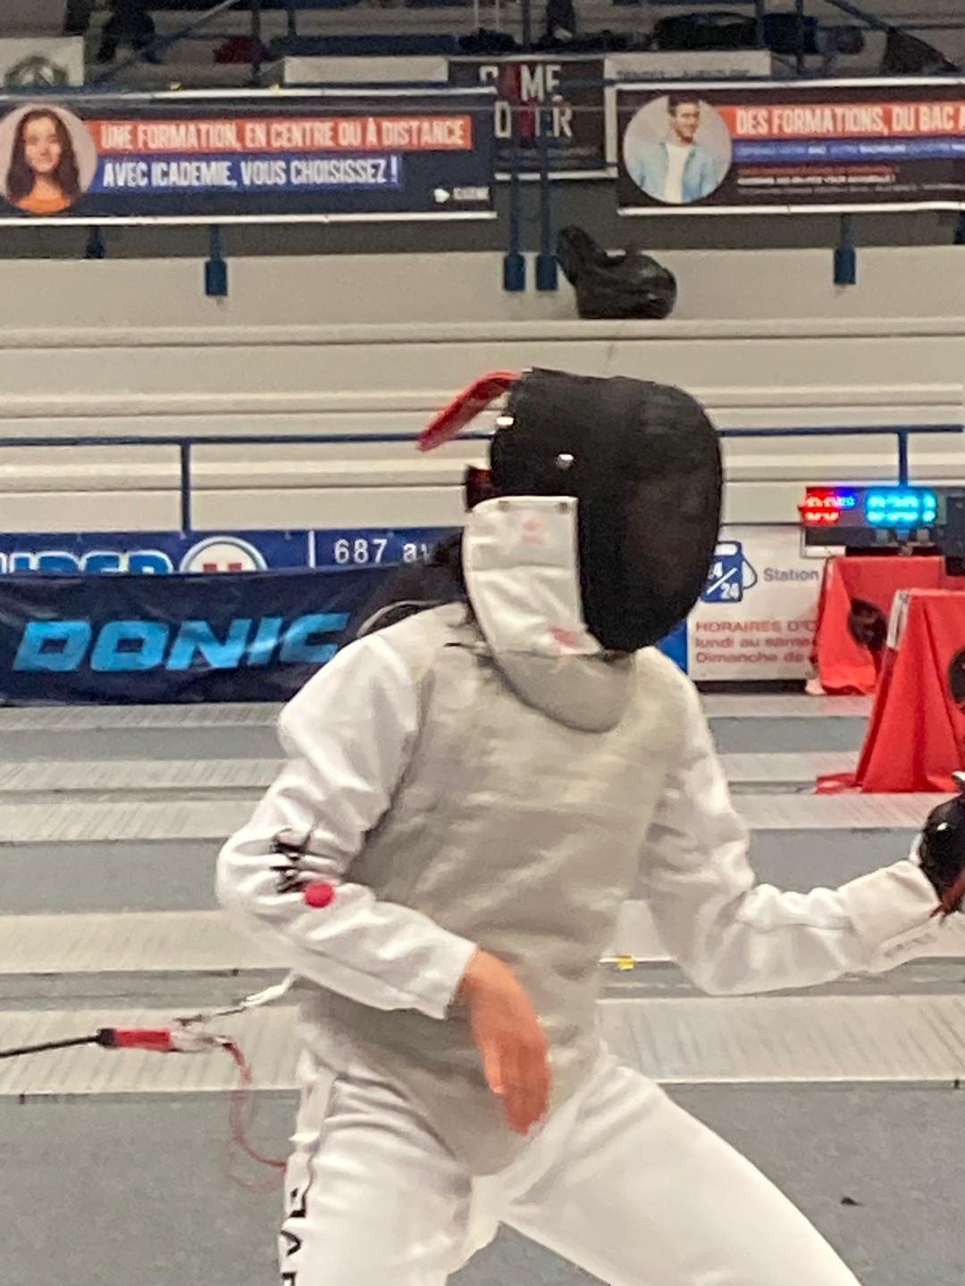
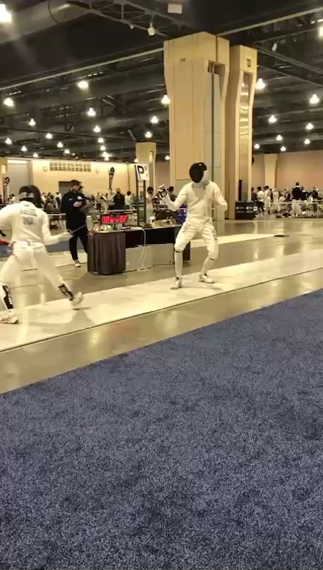
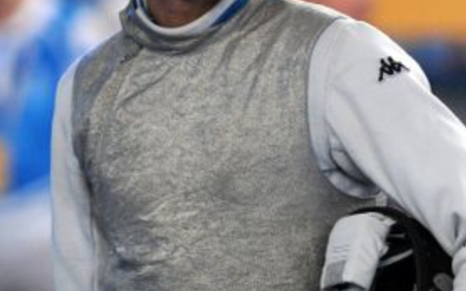
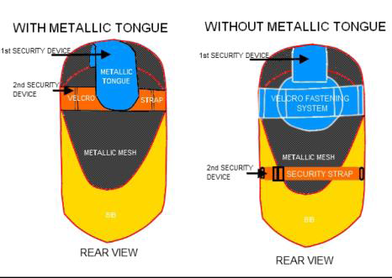
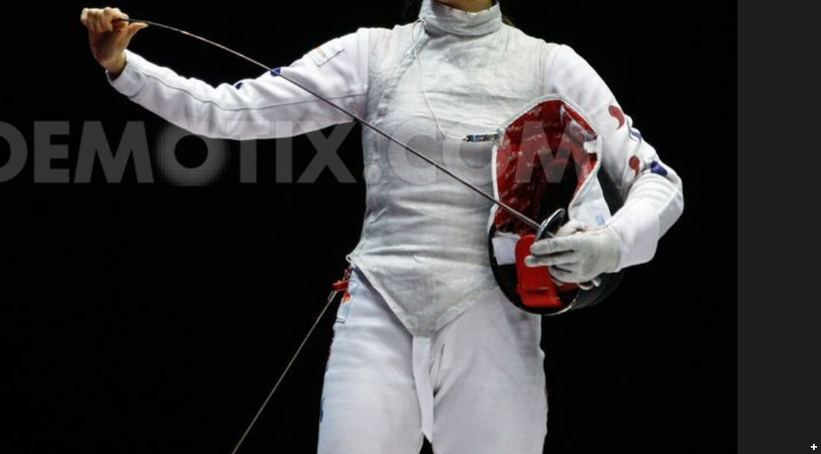
Fencing mask
and equipment

Slide 5
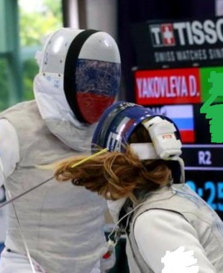
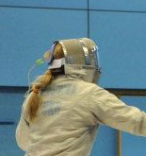
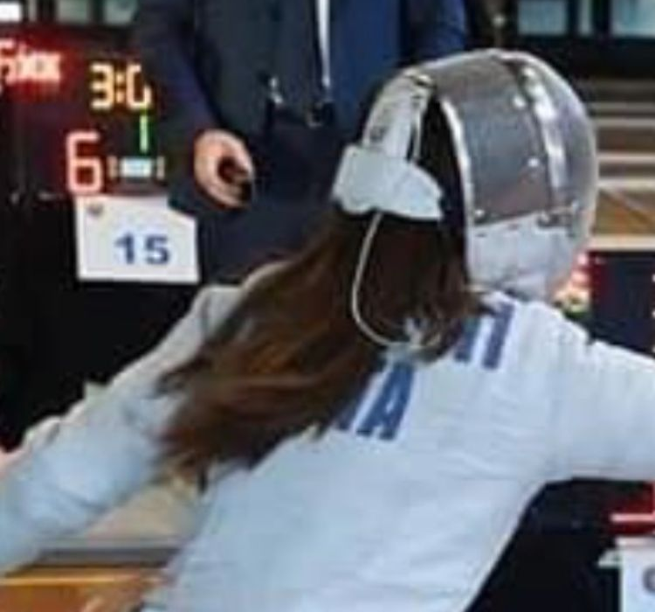
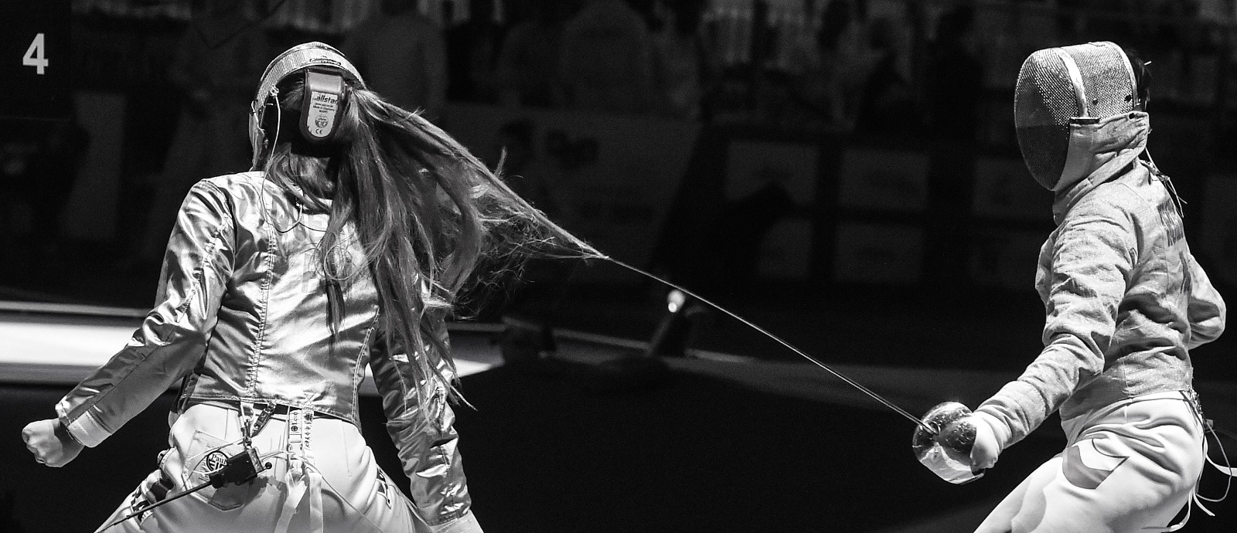
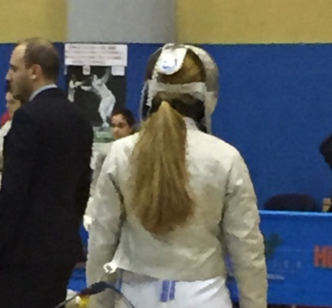
Hair fixing
do not!

Slide 6
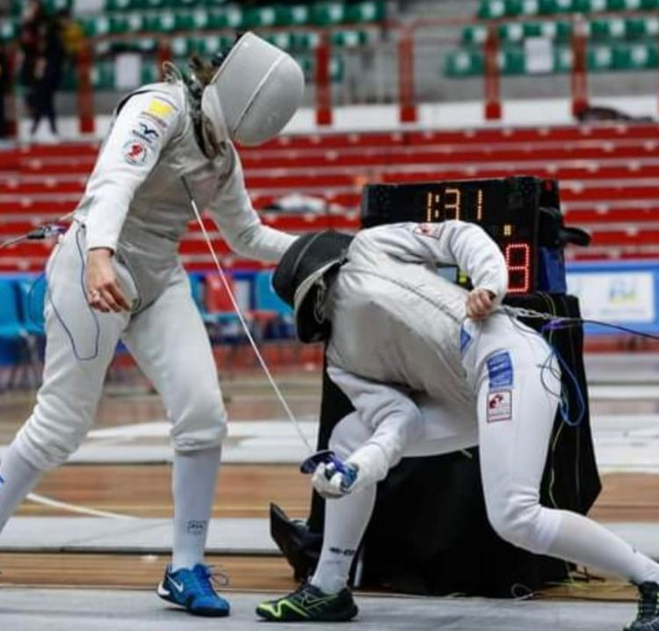
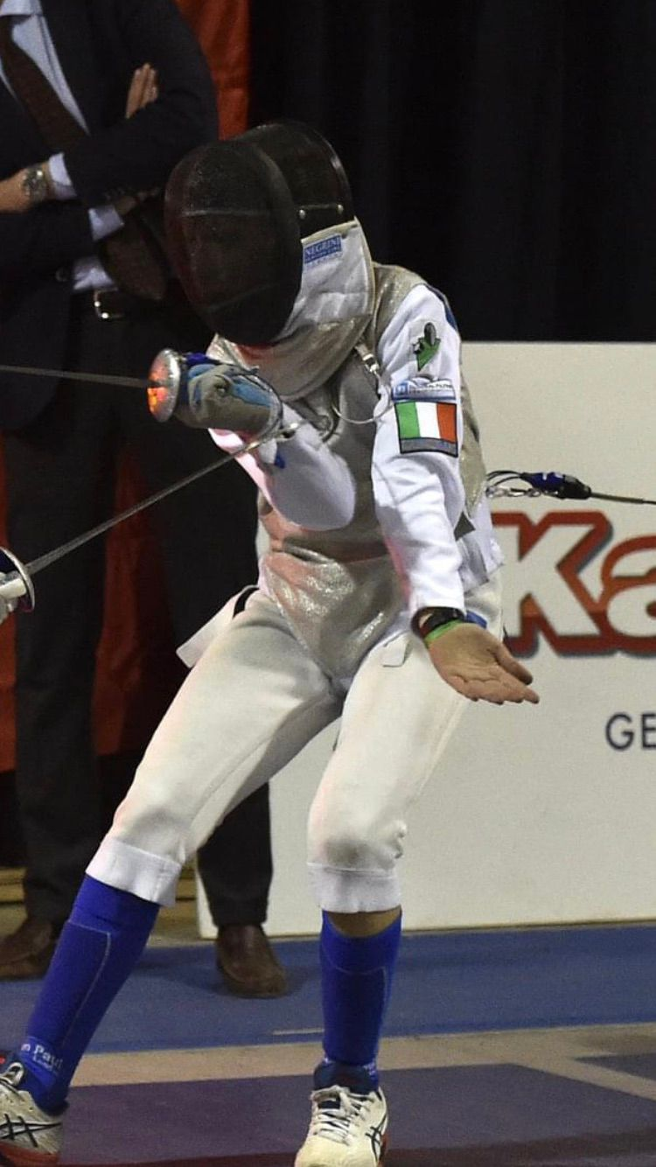
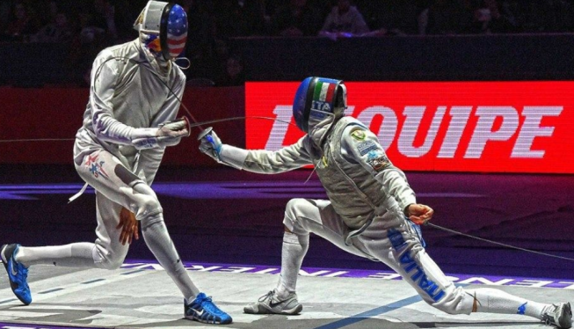
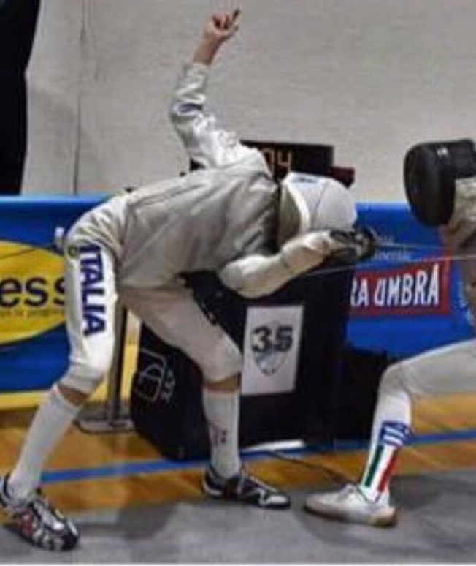
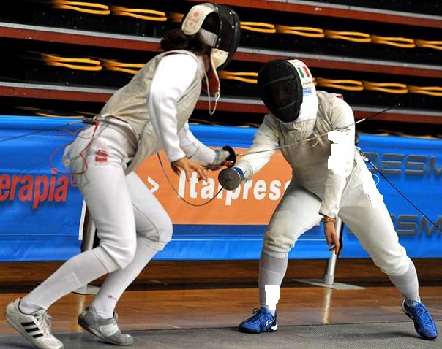
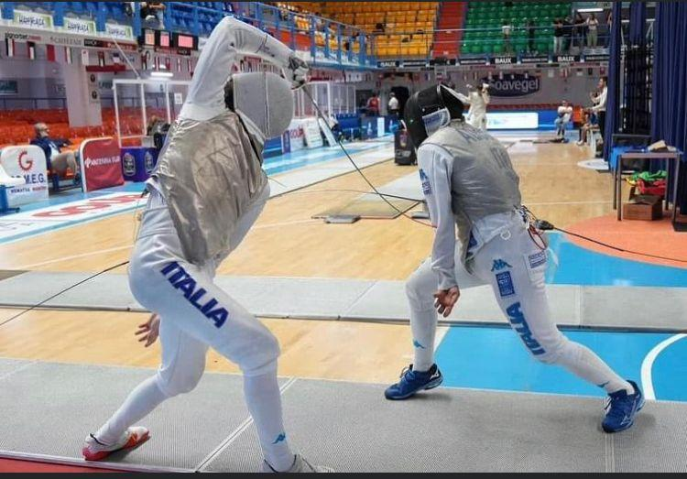
Covering/substitution of valid target

Slide 7
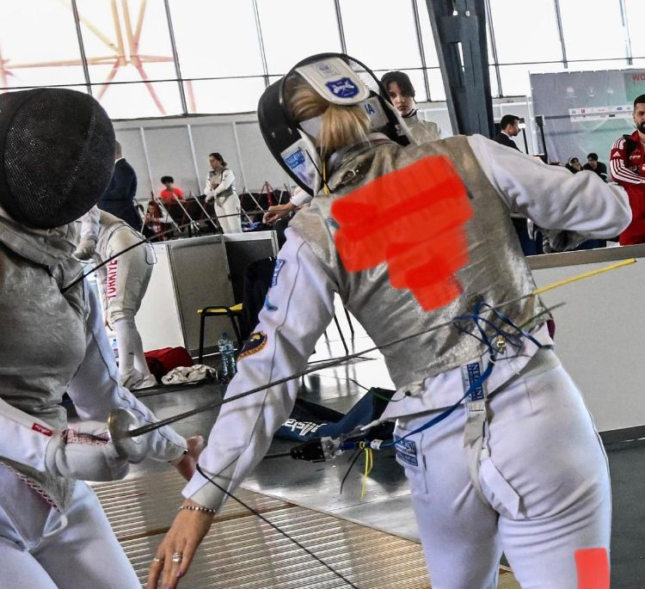
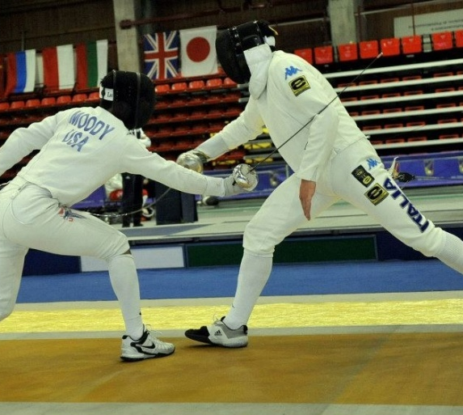
Use of non-sword arm

Slide 8
Point in line
Arm is kept straight
Point has to be on target at all time
Point in line has to be established BEFORE begining of oponent‘s attack
Point in line can be done on no-valid target!

Slide 9
What you can see as PREPARATION?
mistake of the hand or leg
cross steps
stopping
fast contra reactions
During the preparition there is no pressure on opponent
The fastest movement is not necessary, action has to be started first

Slide 10
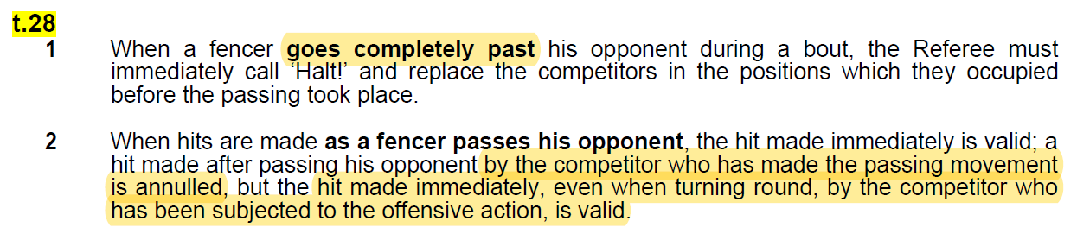
Passing the oponent

Slide 11
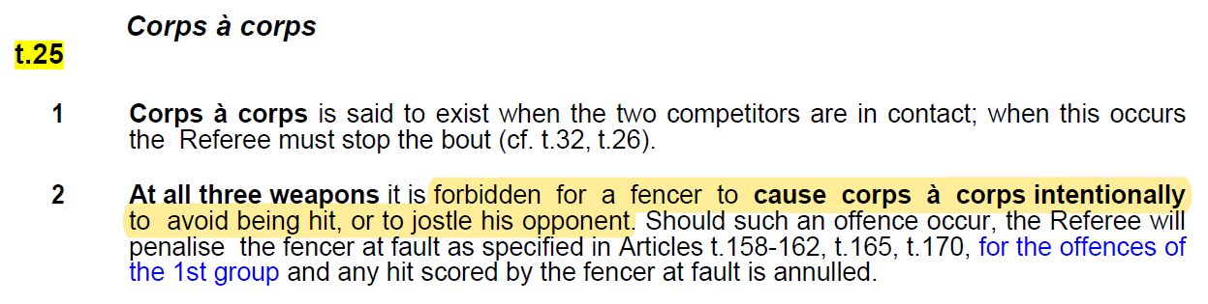
CORP a CORP

Slide 12
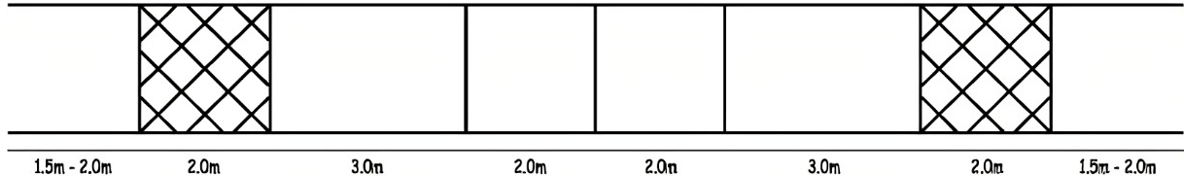
Crossing the limits
Both feets outside
>>> technical touche
end line
on-guard line
centre line
One foot outside >>> 1m back
Two feet outside >>> 1m back and cancel the hit

Slide 13
ALT !
Crossing the limits (first riposte/remise)
Corp a corp simple, to avoid being hit
Passing the opponent (first riposte/remise)
Falling down intentionally or not
Non-combativity
…

Slide 14
Non-combativity
P
P
P
Referee has to say Alt! after 1 minute without hit
> P-yellow for both fencers
>> P-red for both fencers
>>> P-black with lower score (or lower seeding)
! Non-combativity does not exist during 14:14, 44:44 and extra minute

Slide 15
False-start =

Slide 16
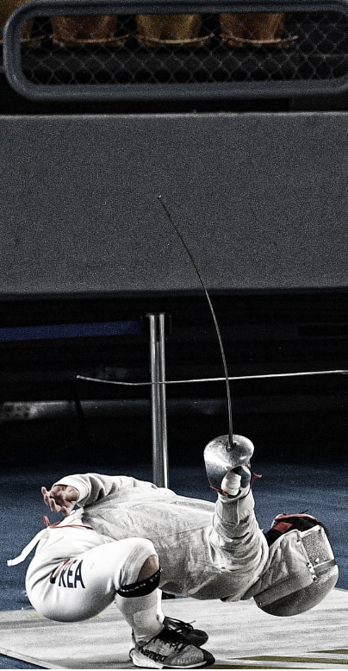
DO NOT ALLOW COACHES TO
COACHING DURING THE FIGHT
Coaching is not allowed after „Allez!“ till „Alt!“. Fencer can have the consultation during 1 minute break. Coach during the poole does not exist and can not be in the area of play.
YELLING AT YOU
No one can yell at You for any reason. You have to controle the bout / match and give the penalties.

Slide 17
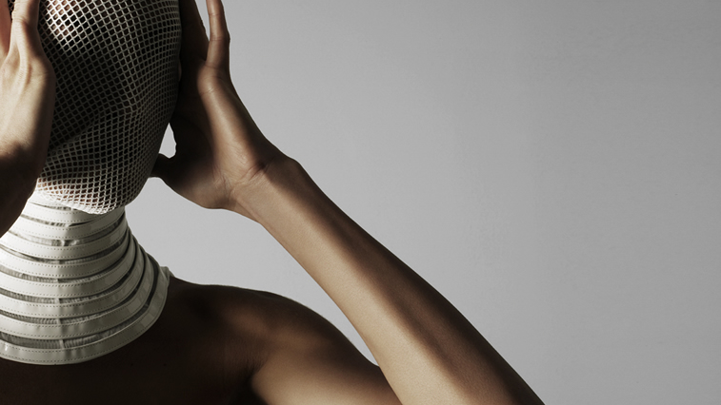
THANKS

